Slide 1
Auto-Regularizied Regression
Learning the Ridge Hyperparameter
By: Jason M. Cherry
May 10, 2017

Slide 2
Agenda
Recap on Linear Regression & Ridge (L2) Regularization
Concept & math behind auto-regularization
Implementation details
Results
Future work
Q&A

Slide 3
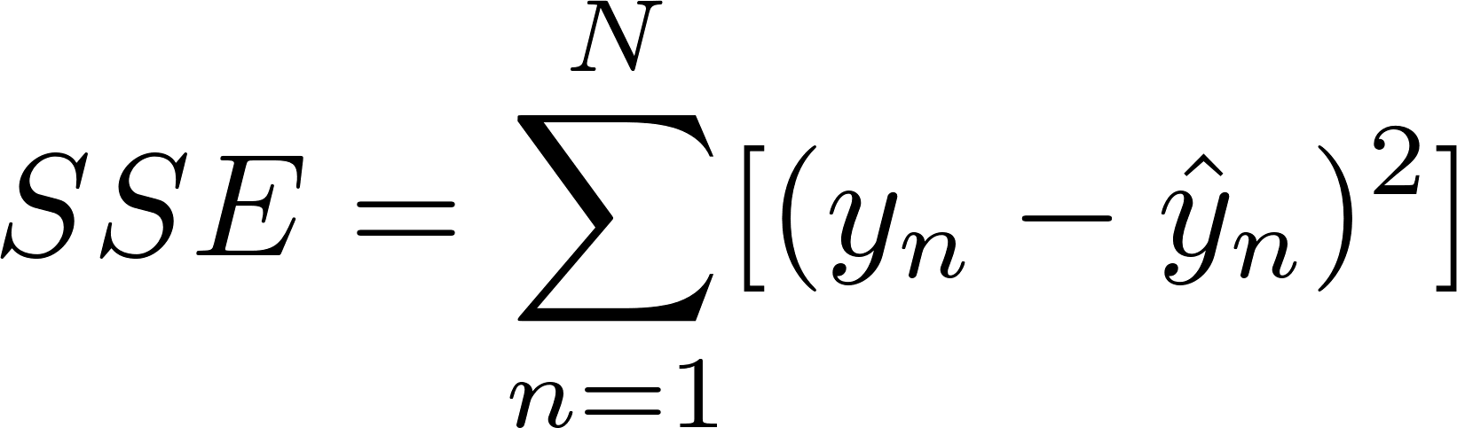
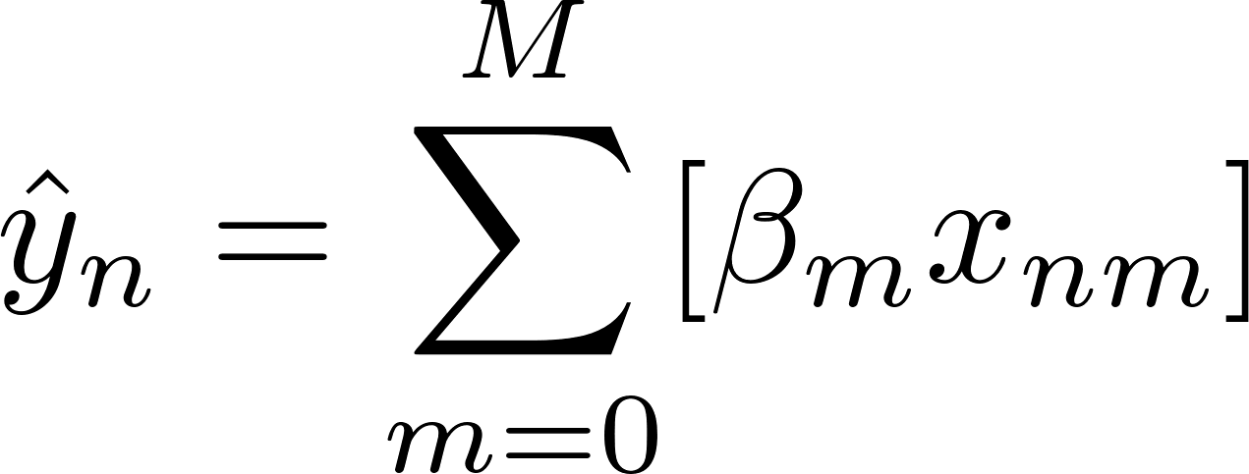
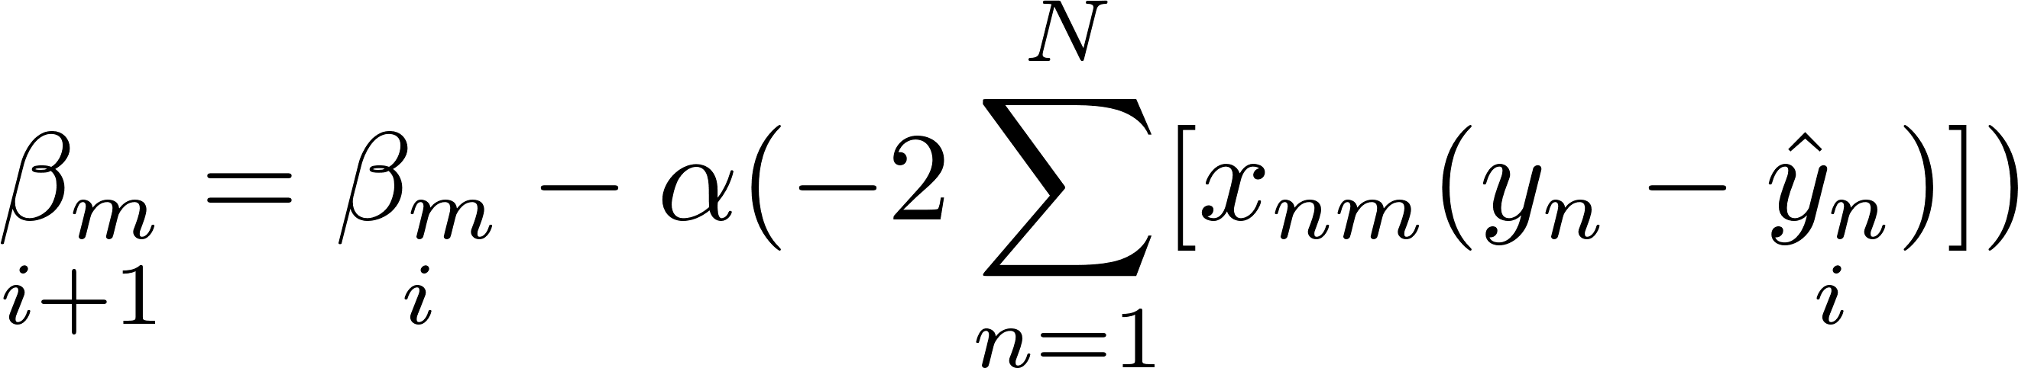
Linear Regression Recap
Linear Regression minimizes Sum of Squared Error:
Gradient Descent most universal application:
Dataset often split into Training & Testing data to determine overfitting

Slide 4
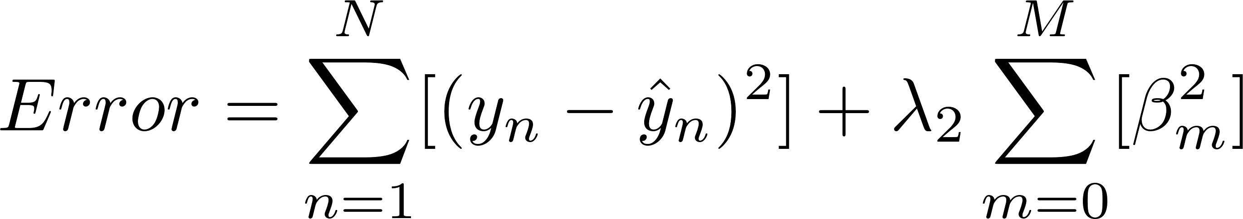
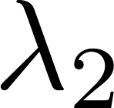
Ridge (L2) Regression Recap
Ridge regression attempts to minimize size of weights
Is an add-on to the SSE formula:
SSE and Ridge are ‘fighting’ for influence in the model
The bigger is the more emphasis is placed on Ridge over SSE
is a manually-input parameter
Often iterative techniques are used to find
e.g. grid search

Slide 5
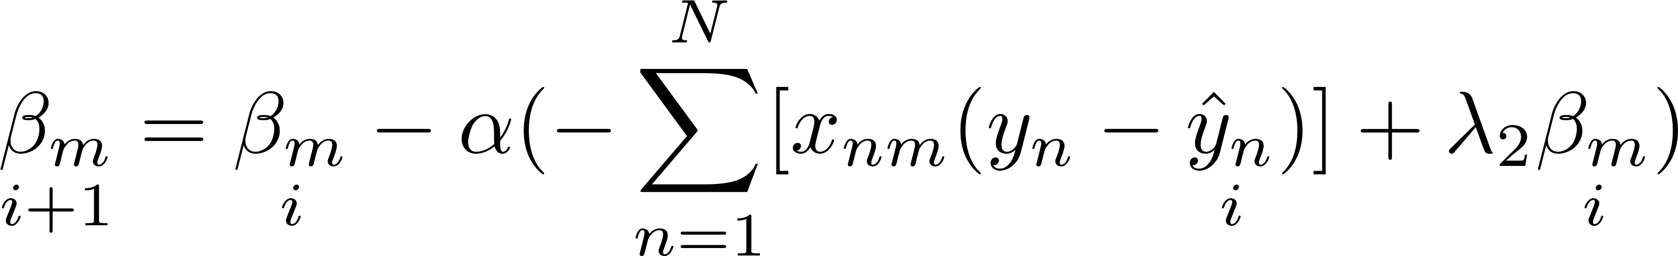
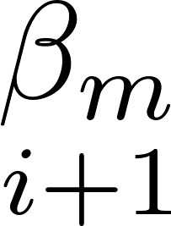
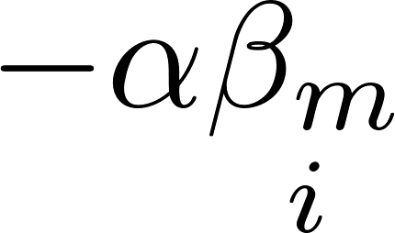
Auto-Regularization Concept/Math – 1
Can be learned using the data? Yes!
Based on work by ---
Identify where shows in process:
Derive from : is just .

Slide 6
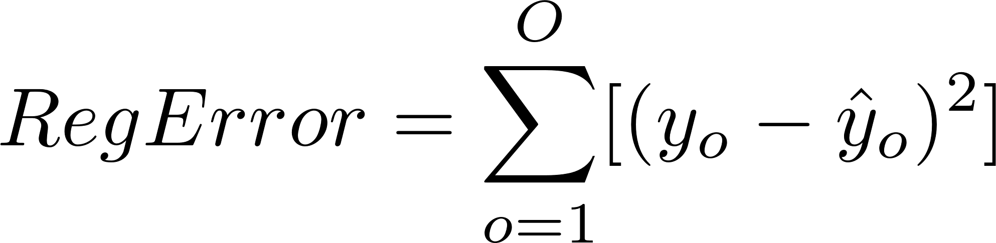
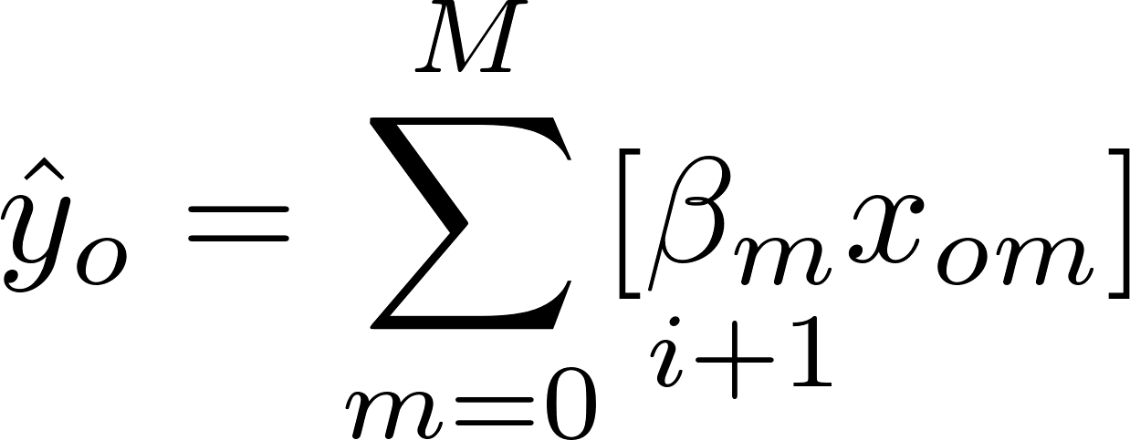
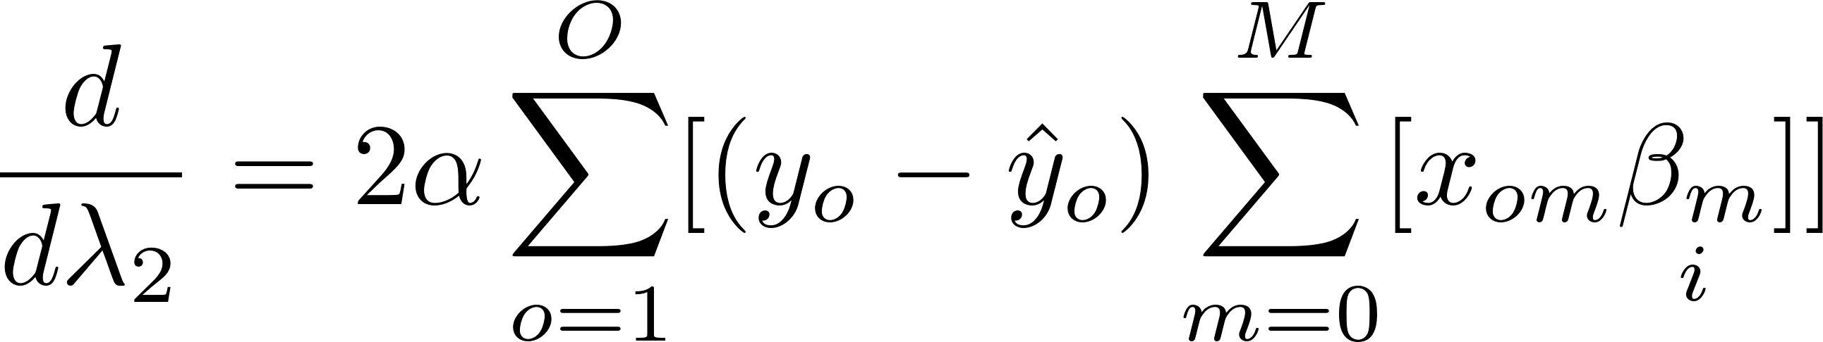
Auto-Regularization Concept/Math – 2
But…
Regularization error needs to be minimized by Lambda:
New derivative:

Slide 7
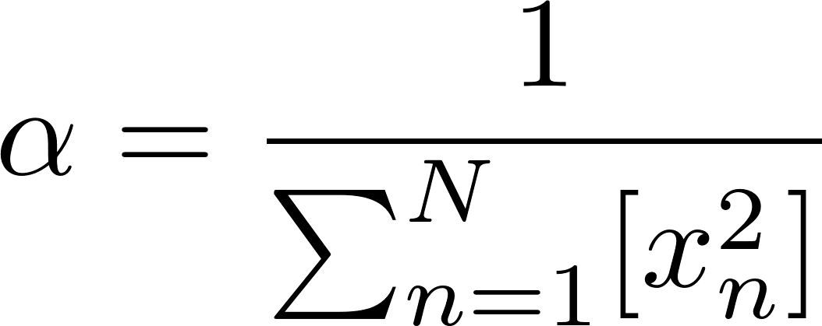
Auto-Regularization Concept/Math – 3
Extended to partial-hessian regression:
Re-deriving gets crazy at this point
Also exponentialized

Slide 8
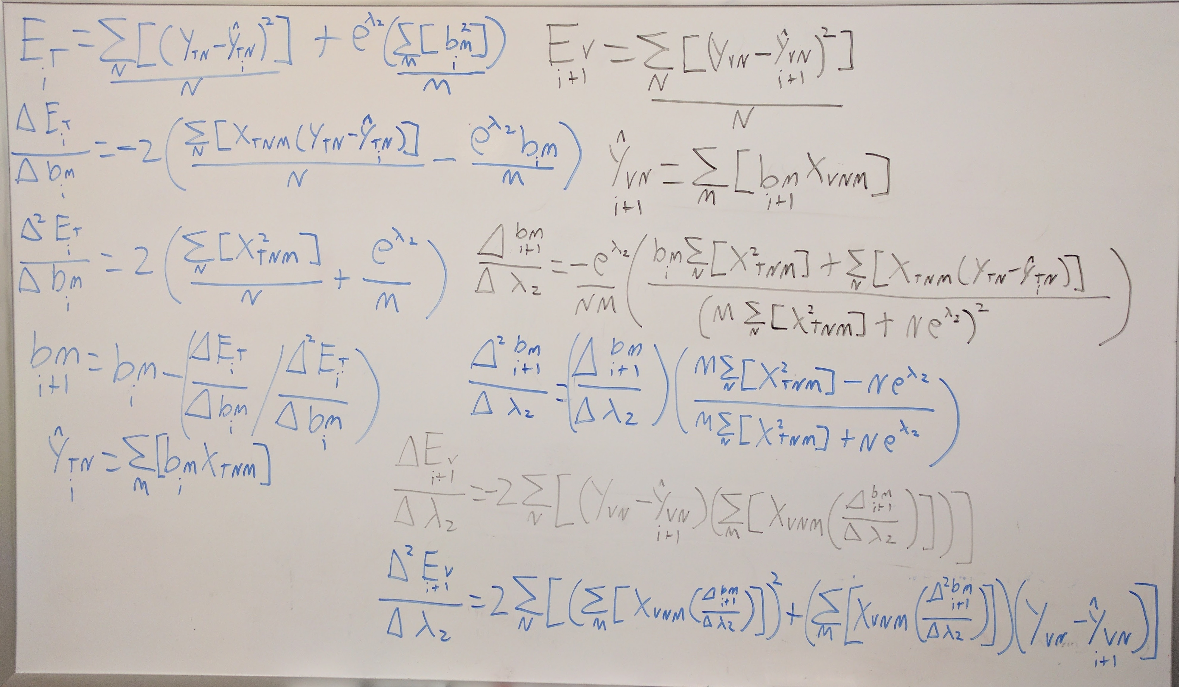
Math… all the math…

Slide 9
Initialization
Math and concept understood – now to test!
1000-iteration gradient descent
First comparing to standard linear regression
Then comparing to grid-search regularized regression
kd_house_data from University of Washington’s Machine Learning Coursera class
100 randomizations, 50% training, 25% validation, 25% testing
All data normalized – z-score
Compare error on test sets
Standard regression, grid-search regularization, and auto-regularization

Slide 10
Results
Four types of results:
Auto-Reg Fails
Two types of failures
Unregularizable
No Regularization Needed
Auto-Reg Works

Slide 11
Auto-Regularization Fails – Type 1

Slide 12
Auto-Regularization Fails – Type 1

Slide 13
Auto-Regularization Fails – Type 1

Slide 14
Why did Auto-Reg Fail? – Type 1
Auto-Reg and Standard regression stayed very close
Auto-Reg converged on Ridge Weight of 0 rather quickly
By iteration 20 Ridge Weight was already < 0.001
Exponentialized version of formula multiplies result by Ridge Weight
Conclusion: Smaller Ridge Weight convergence values death-spiral to 0

Slide 15
Auto-Regularization Fails – Type 2

Slide 16
Auto-Regularization Fails – Type 2

Slide 17
Auto-Regularization Fails – Type 2

Slide 18
Why did Auto-Reg Fail? – Type 2
Standard and Grid methods get decent error on Test data
Grid and Auto-Reg get high, but reasonable error on Validation data
Auto-Reg converges the Ridge Weight to a non-zero value
Conclusion: overfitted on Validation data

Slide 19
Unregularizable

Slide 20
Unregularizable

Slide 21
Unregularizable

Slide 22
Why is this iteration unregularizable?
All three models performed poorly on Test data
All three models performed well on Validation data
Conclusion: Validation data is a poor representation of Test data

Slide 23
No Regularization Needed

Slide 24
No Regularization Needed

Slide 25
No Regularization Needed

Slide 26
Why is no regularization needed?
All models perform well on Validation and Test data
Auto-Reg and Grid both converge at Ridge Weight of 0
Conclusion: No overfitting, and datasets are representative of each other

Slide 27
Auto-Regularization Works

Slide 28
Auto-Regularization Works

Slide 29
Auto-Regularization Works

Slide 30
Why did Auto-Reg work?
With both Test & Validation data, Grid & Auto-Reg converged to acceptable errors
Auto-Reg had erratic Ridge Weight convergence for ~40 iterations, but never got close to 0
Conclusion:
Didn’t overfit on Validation data
Validation data is representative of Test data
0 is bad for the Auto-Reg learning formula

Slide 31
Model Performance - Comparison
Standard Regression: 5.47 seconds
Grid Search Regularization: 92.4 seconds
Auto-Regularization: 7.77 seconds

Slide 32
Conclusion
Formula quirk – Auto-Reg converges to 0 with small values of optimal Ridge Weight
Overfitting – Auto-Reg is more prone to overfit to the combination of the Training & Validation set than Grid
Worst-Case, Auto-Reg predicts comparable to Standard
Auto-Reg has a run-time only ~50% longer than Standard
Grid has a run-time over 1650% longer than Standard
Conclusion: Use when run-time is a premium, but some regularization may be needed.

Slide 33
Next Steps
Revisit Non-exponentalized
Is this generalizable to other loss functions? Try with Logistic
Allow distinct per weight? More severe overfitting?
Would this work in Neural Nets?
Can this be applied to Lasso?

Slide 34
Fin
Presentation by Jason M. Cherry – Jcherry@gmail.com
Data/code/material available on GitHub at https://github.com/Calvinxc1/AutoReg_Presentation

